Slide 1


Confirming Eligibility
V3.0 29-OCT-2025
Chief Investigator: Prof Anthony Gordon
Study Coordination Centre:
Imperial Clinical Trials Unit
IRAS ID: 1005848
REC ref: 23/LO/0339
Sponsor: Imperial College London
Funder: NIHR
IRAS ID: 1005848
REC ref: 23/LO/0339

Slide 2
Coordinating Centre / Trial Management Team
Trial coordinated by Imperial Clinical Trials Unit
Chief Investigator: Prof Anthony Gordon
Trial Manager: Ravinder Dhaliwal
Trial Monitor(s): Paulina Kuswik and Promi Kamali
  Email: septic@imperial.ac.uk
Address:
Room 1064, 10th Floor, QEQM
St Mary’s Hospital
1 Praed Street
London
W2 1NY

Slide 3
Introduction to SepTiC
A multi-centre, pragmatic, multi-factorial, open-label randomised controlled trial, with an embedded randomised, double-blind, parallel group trial.
Research questions
Do rapid PCR-based microbiological diagnostics plus procalcitonin improve outcomes and antibiotic stewardship compared to standard care in patients admitted to ICU with sepsis?
Does conservative fluid therapy with active removal of accumulated fluid (de-resuscitation) improve outcomes compared to standard care in patients …with sepsis?
Does GM-CSF compared to placebo improve outcomes in a high-risk subset of patients …with sepsis?
What is the relative cost-effectiveness of each of these interventions compared to current standard of care?

Slide 4
Confirming Eligibility
As per MHRA requirements only a clinician is able to confirm whether a patient is eligible for the trial.
The clinician confirming eligibility is required to be listed on the delegation log and must be listed on the Eligibility Check log so that the study has oversight of those clinicians who have received this training and are qualified to confirm eligibility.
Eligibility should be confirmed for the trials the patient is eligible for, i.e. they may be eligible for trials 1+2 first and 3 (GM-CSF) later, therefore eligibility should be checked for trial 3 (GM-CSF) when the patient is eligible. This needs to be documented in the medical records.
Please ensure a ‘Eligibility Form’ is completed for each eligible patient and filed in their medical records.

Slide 5
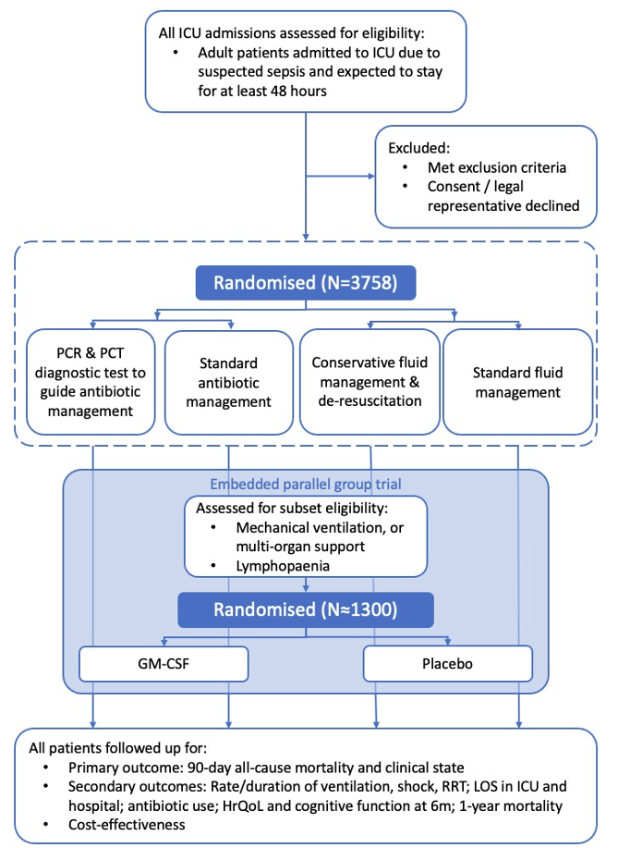
Study Flowchart

Slide 6
Inclusion Criteria – All participants
Adult patients (≥16 yrs) admitted to ICU due to suspected sepsis and expected to stay for at least two calendar days (i.e. expected to still to be in ICU the day after tomorrow)
Receiving intravenous antibiotics for suspected sepsis
According to local clinical judgement, patient has received adequate initial early fluid resuscitation

Slide 7
Exclusion Criteria – All participants
More than 24 hours since ICU admission (not for GM-CSF arm, see next slide)
Previously admitted to ICU due to sepsis on this hospital admission
Not expected to survive initial resuscitation (24 hours)
Neutropaenia due to chemotherapy / malignancy (but not due to sepsis)
Being treated for infective endocarditis, osteomyelitis, hepatic or cerebral abscess, tuberculosis
DKA / HHS / DI / SAH (in last 21 days)
Weight <40Kg

Slide 8
GM-CSF Trial - Inclusion criteria
The patient may not be eligible for the GM-CSF trial now, but please check again if the patient becomes more unwell.
Intubated, mechanically ventilated & expected to continue for another 24 hours
Or
Requiring two organ support (i.e. two of vasopressors, renal replacement therapy, or non-invasive ventilation / continuous positive airway pressure / high flow nasal oxygen respiratory support)
AND
An absolute lymphocyte count <1.2 x10⁹ /L on two consecutive calendar days
(at least 12 hrs apart with no values >1.2 x10⁹ /L in between)

Slide 9
Additional Exclusion criteria – GM-CSF
More than 120 hours (5 days) since ICU admission
Already receiving G-CSF or GM-CSF
A total white blood cell count (WBC) >50 x10⁹ /L
Allergy or adverse reaction to GM-CSF or yeast-product
Known to be pregnant or lactating
Known active haematological malignancy (treated within last 5 years)
Solid organ or bone marrow transplantation
Patient weight >125kg

Slide 10
Good Clinical Practice (GCP)
International, ethical and scientific quality standard to which all research involving human participants is conducted
Comprised of 13 core principles & applies to all clinical investigations that could affect safety and well-being of human participants, providing international assurance that:
  Data and reported results of clinical investigations are credible and accurate
  Rights, safety and confidentiality of participants in clinical research are respected and protected
You are encouraged to obtain GCP certification, such as that available through NIHR: https://www.nihr.ac.uk/health-and-care-professionals/learning-and-support/good-clinical-practice.htm

Slide 11
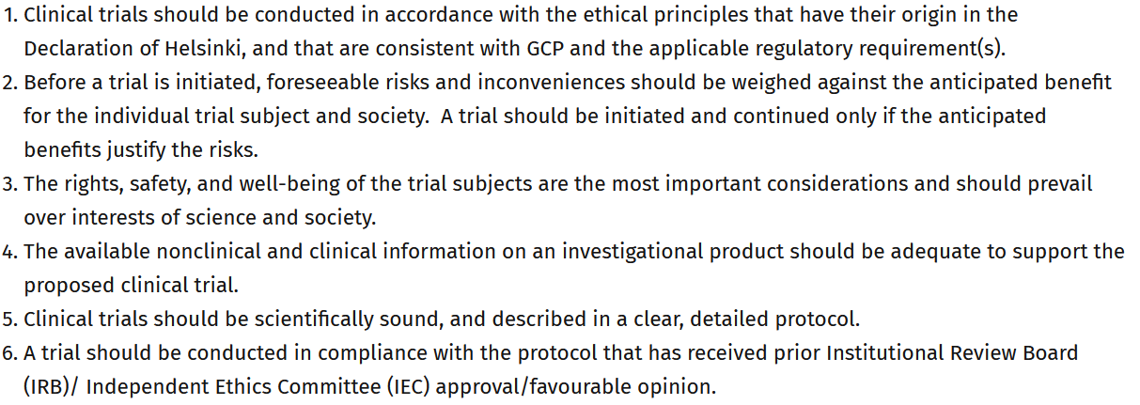
Principles of Good Clinical Practice (GCP)

Slide 12
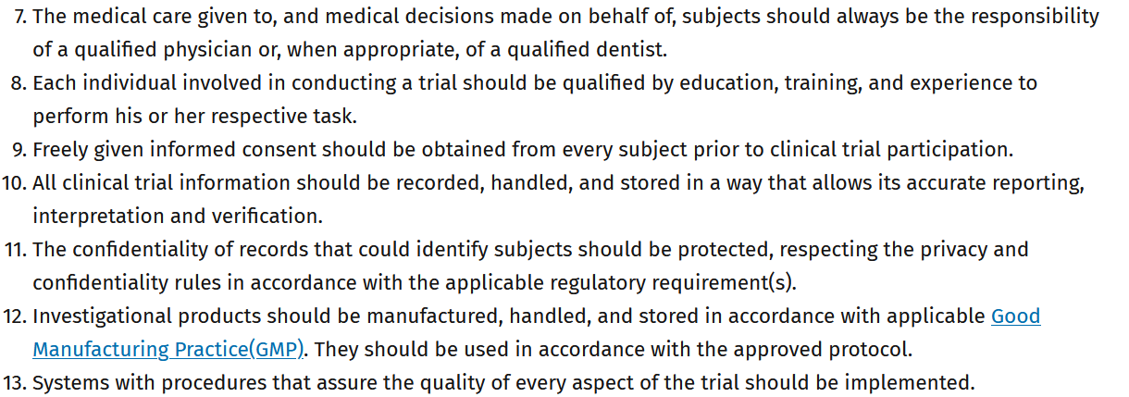
Principles of Good Clinical Practice (GCP)

